Slide 1
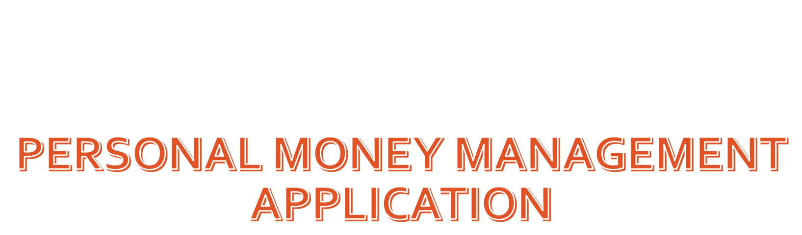
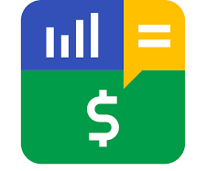

Slide 2
Content
Purpose
Introduction
  Problem specification
  Requirements specification
Objectives
Functional Requirements

Slide 3
Purpose
My aim is to develop a Expenses tracking and budgeting system. This application is a web application typically used to manage day-to-day expenses and incomes.
From this application, I am going to demonstrate about development technologies like java, spring, ReactJS, MySQL and microservices architecture .

Slide 4
Introduction
Money management application is used to manage our day to day expenses and incomes. It helps users to manage their income within their budget limits.
Using this application we can
  Make efficient track of our transactions
  Limit expenses
  Identify the major expenses requirements
  Reduce time wastage of tracking and calculating our expenses manually

Slide 5
Requirements Specification
User access for multi users.
Transaction details with a
  Transaction identification number
  Transaction type
  Transaction category
  Amount
  Date
  Note
Update and delete transactions
Create and delete transaction categories
Specify budget limits for expense categories
View latest transactions
Log file which keeps the logging details and the activities done in the logged period

Slide 6
Objectives
General
  Developing an application to allow a user to track day-to-day expenses and limit expenses
Specific
  To implement interfaces for permission control and allow user handling
  To allow the user to track transactions, set budget limits for expense categories and view them in different classifications

Slide 7
Functional Requirements
User Access Level Management
Income Management
Expense Management
Category Management
Budget Management

